Slide 1

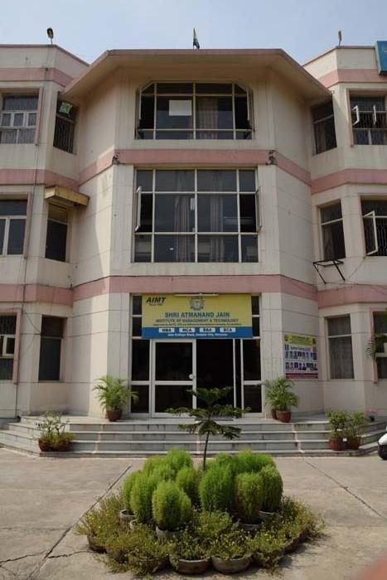
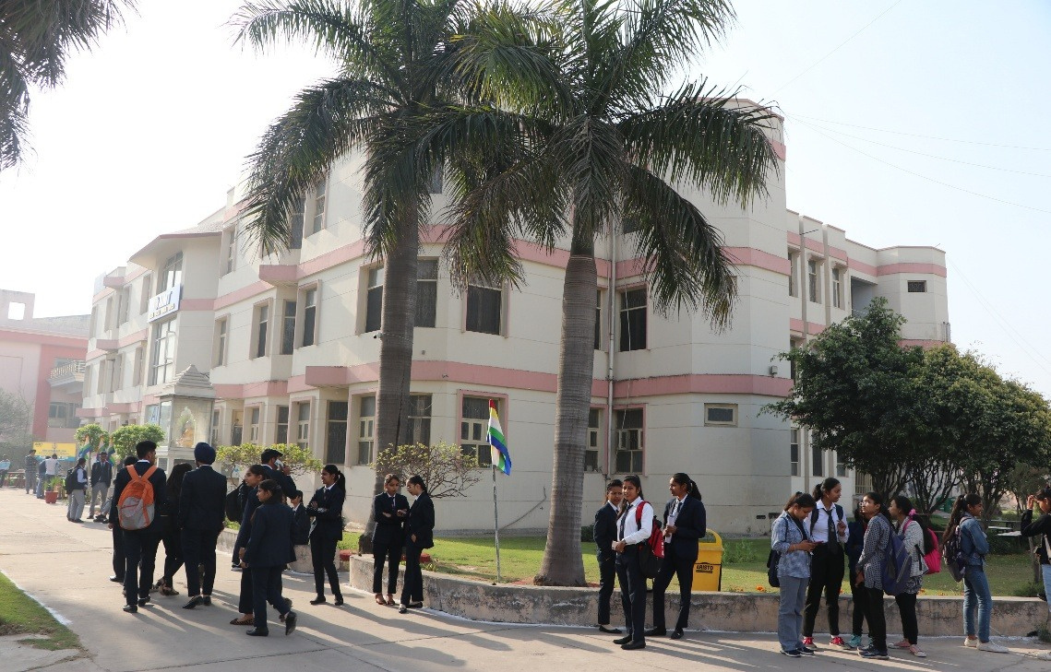


SHRI ATMANAND JAIN
INSTITUTE OF MANAGEMENT & TECHNOLOGY
(Approved by AICTE,DTE Govt. of Haryana & Affiliated to Kurukshetra University, Kurukshetra)
INSTITUTIONAL AREA,JAIN COLLEGE ROAD,AMBALA CITY

Slide 2





WELCOME
TSSC TEAM AND FOCALYT
UNDER
SAMSUNG INNOVATION CAMPUS

Slide 3
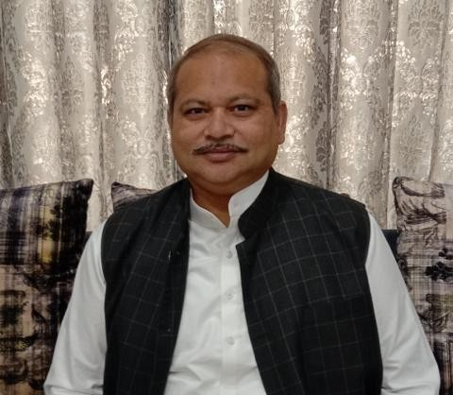
WELCOME
OUR CHIEF GUEST
MR. HITESH JAIN SIR
(MUNICIPAL COUNCILLOR MEMBER, BJP, AMBALA CITY)

Slide 4

WELCOME
OUR GUEST
MR. RK SHARMA SIR
SM (Retd) to TSSC

Slide 5
WELCOME
OUR GUEST
MR. PARVEEN BANSAL SIR
FOUNDER AND CEO OF FOCALYT

Slide 6
WELCOME
OUR GUEST
MR. SACHIN MISHRA SIR
VICE PRESIDENT, FOCALYT

Slide 7

SHRI ATMANAND JAIN
INSTITUTE OF MANAGEMENT & TECHNOLOGY
(Approved by AICTE,DTE Govt. of Haryana & Affiliated to Kurukshetra University, Kurukshetra)
INSTITUTIONAL AREA,JAIN COLLEGE ROAD,AMBALA CITY

Slide 8

SHRI ATMANAND JAIN
INSTITUTE OF MANAGEMENT & TECHNOLOGY
(Approved by AICTE,DTE Govt. of Haryana & Affiliated to Kurukshetra University, Kurukshetra)
INSTITUTIONAL AREA,JAIN COLLEGE ROAD,AMBALA CITY

Slide 9
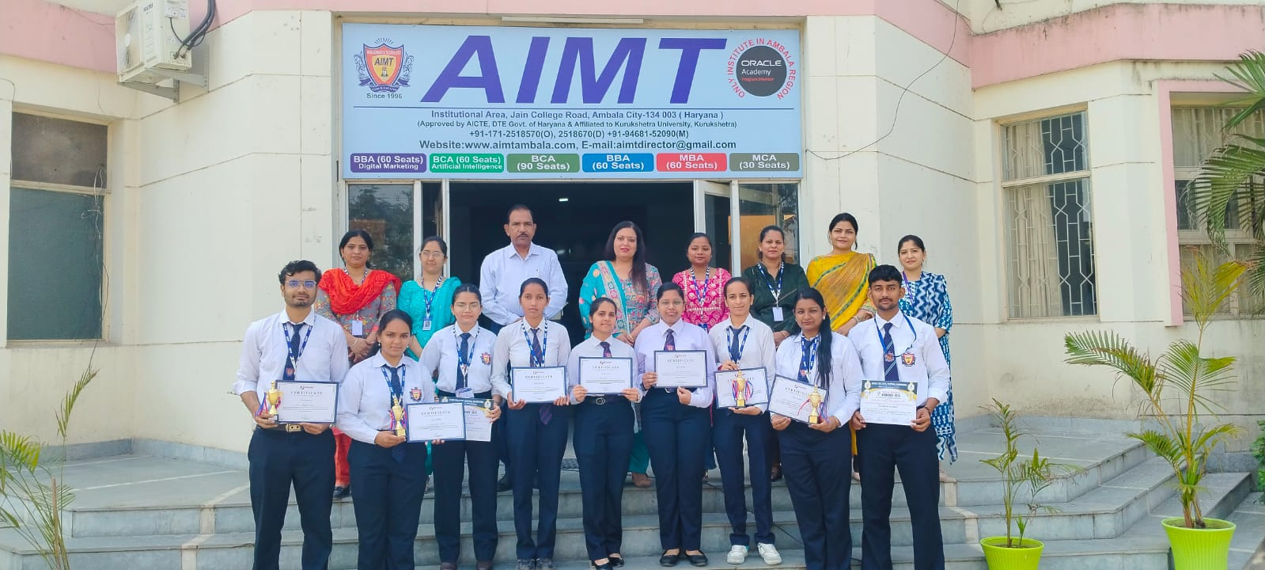
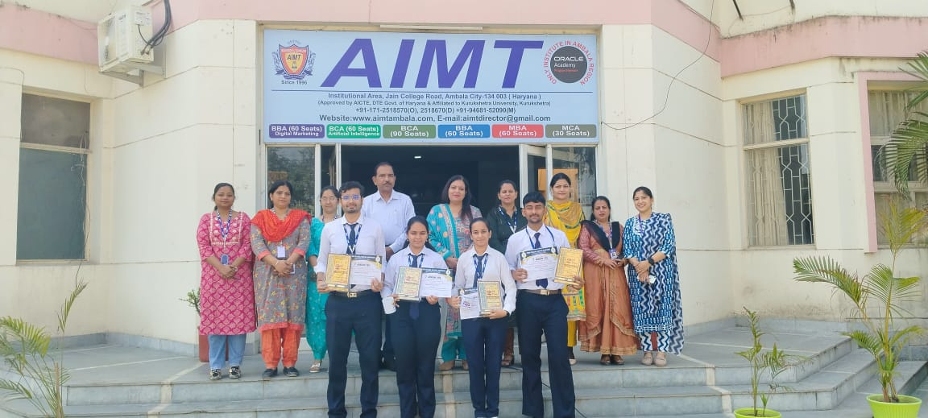
CERTIFICATE DISTRIBUTION CEREMONY
SHRI ATMANAND JAIN
INSTITUTE OF MANAGEMENT & TECHNOLOGY
(Approved by AICTE,DTE Govt. of Haryana & Affiliated to Kurukshetra University, Kurukshetra)
INSTITUTIONAL AREA,JAIN COLLEGE ROAD,AMBALA CITY

Slide 10


